Slide 1
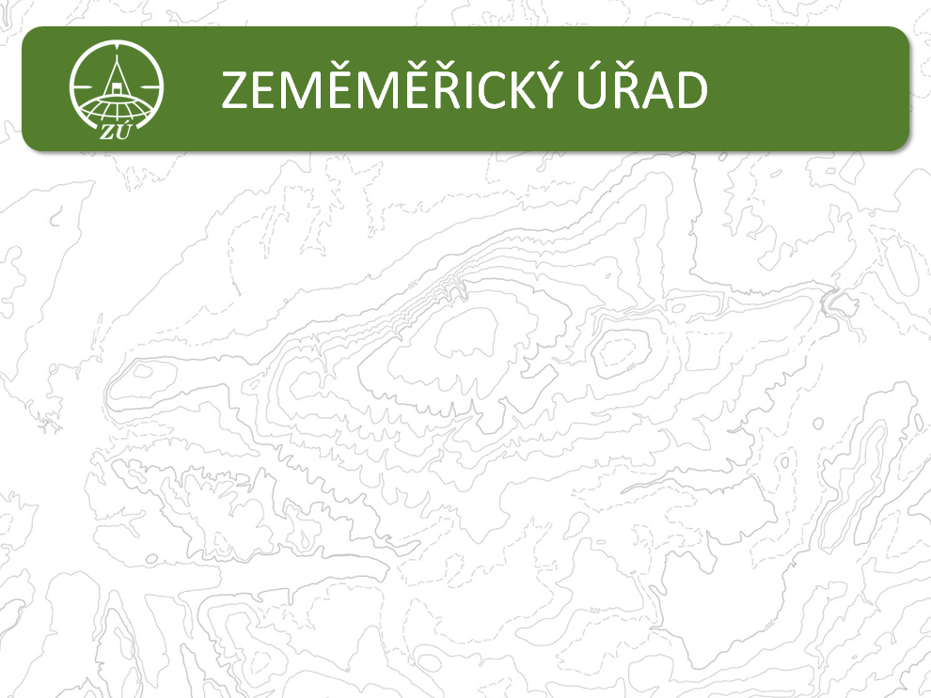



POSKEN
National Report of the Czech Republic:
GNSS/geodetic activities in 2017
Czech Office for Surveying, Mapping and Cadastre
Land Survey Office, Department of Geodetic Control
Research Institute of Geodesy, Topography and Cartography, Geodetic Observatory Pecný

Slide 2

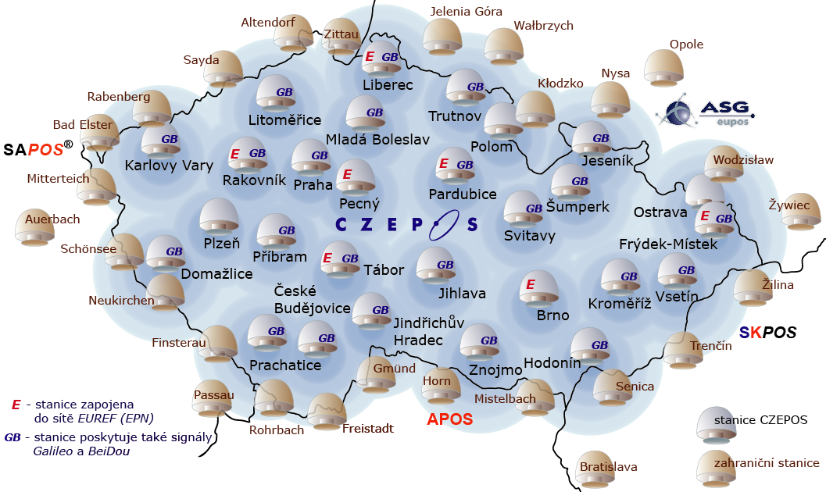
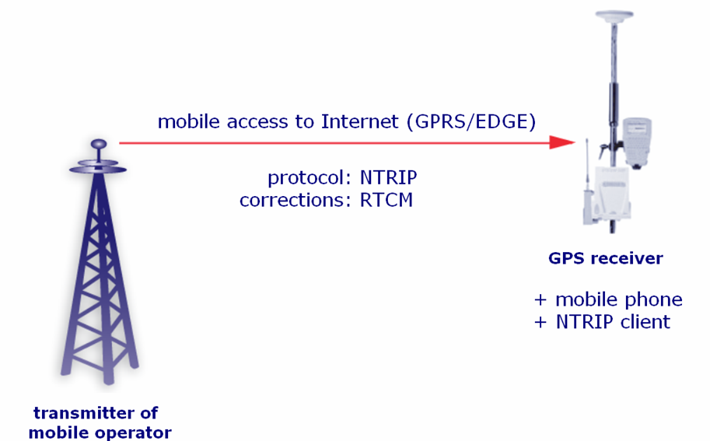



Administration of CZEPOS network
28 Czech stations
27 neighboring stations
real-time services
post-processing products
GPS/GLONASS
2017 Galileo
+ BeiDou
23 of 28 stations
receives only
GPS signals
7 stations involved in EUREF permanent network (EPN)
cooperation within EUPOS project
2018/04: 1610 users

Slide 3
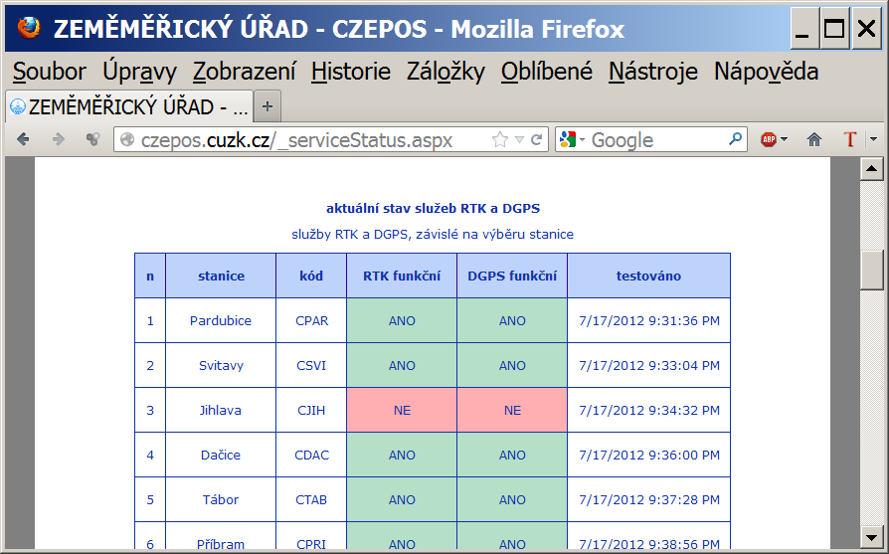
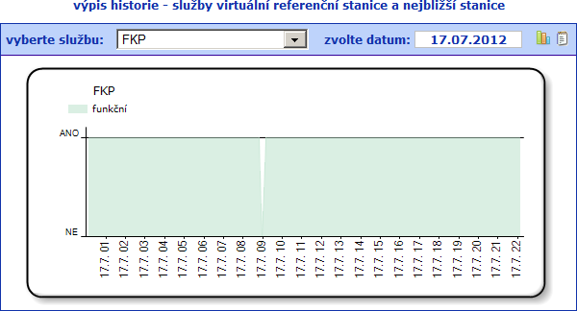
Administration of CZEPOS network
monitoring of operation

Slide 4
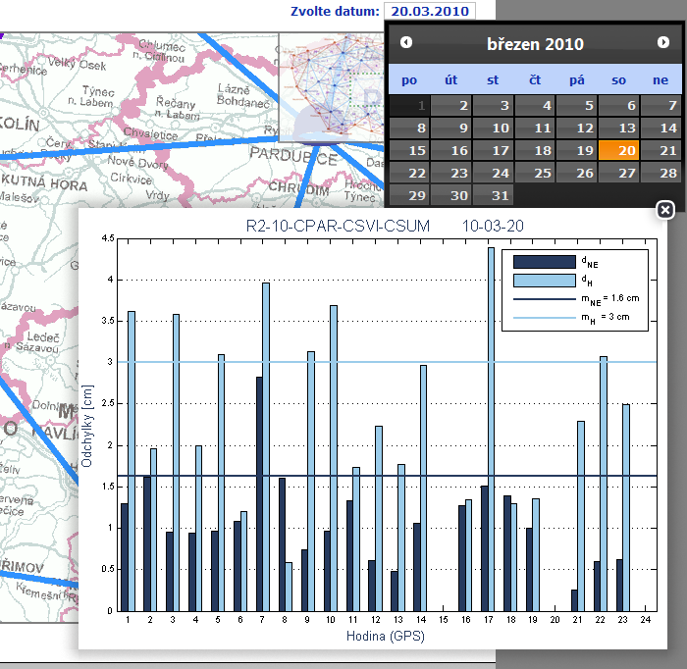
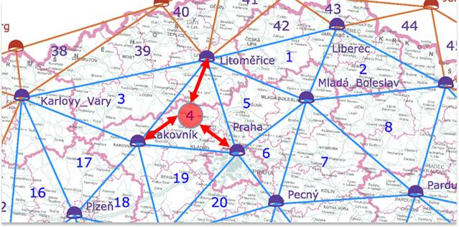
Administration of CZEPOS network
monitoring of accuracy
Internet application, created in cooperation with CTU
75 testing areas on the territorry of CR including border areas
there are 3 testing baselines in each area
each baseline is tested from RTK x VRS service

Slide 5
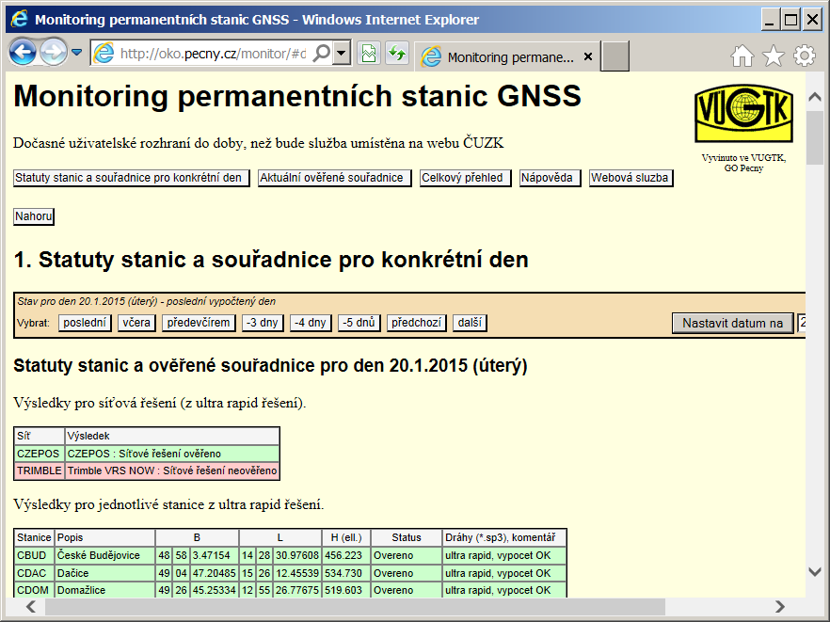
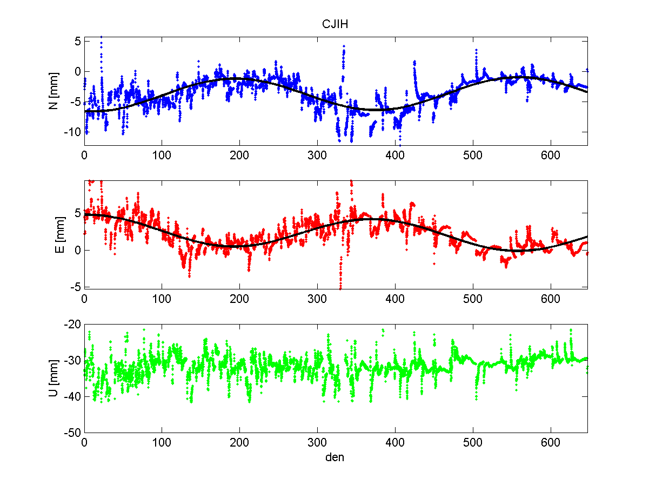
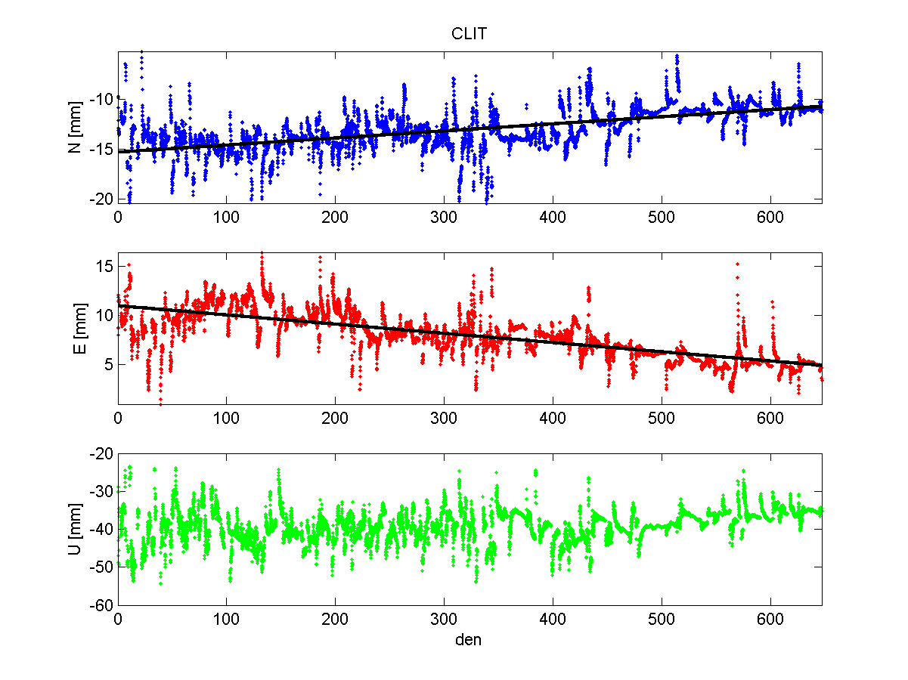
Administration of CZEPOS network
monitoring of stability
Cooperation with Research Institute of Geodesy and Cartography

Slide 6
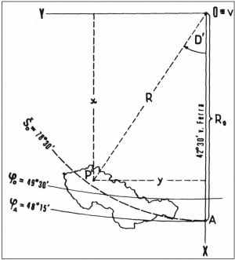
Reference Frames - Positional Transformation
European Terrestrial Reference System 1989 (ETRS89)
Coordinate System of Uniform Trigonometric Cadastral Network
(S-JTSK)
3D Helmert transformation
equations of Krovak projection
Interpolation in the grid of local differences

Slide 7
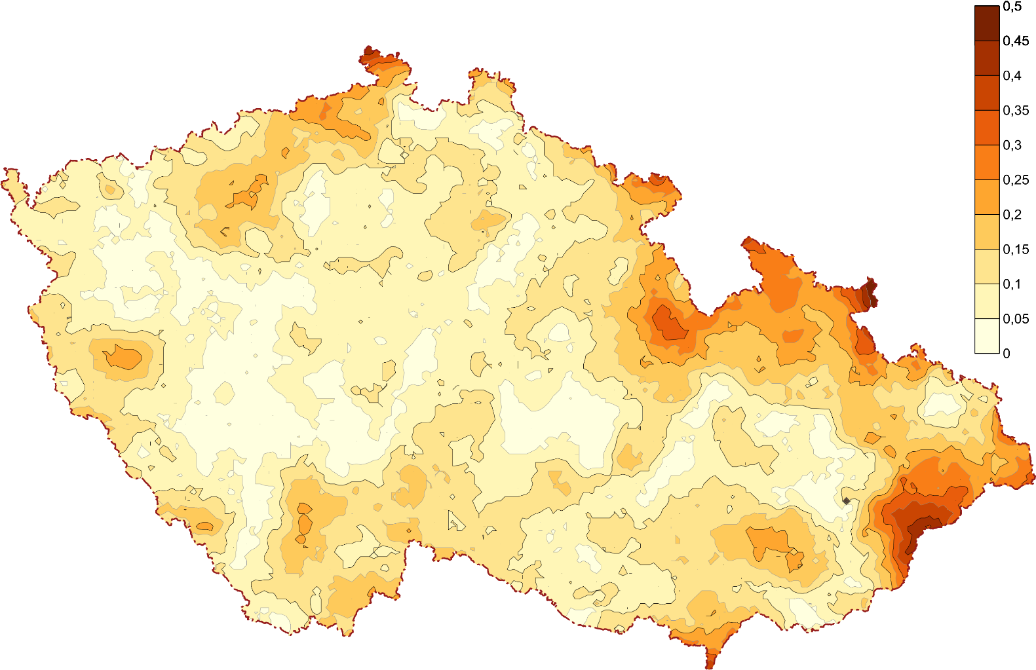
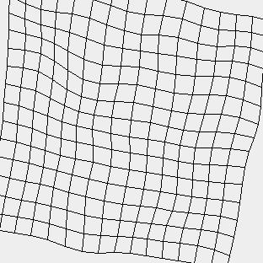
Positional Transformation – grid of local differencies
- Previous grid — realization 2012
- New realization 2017:
new GNSS measurements 2014-2017, smoother changes
higher density of points in the areas of state boundaries

Slide 8
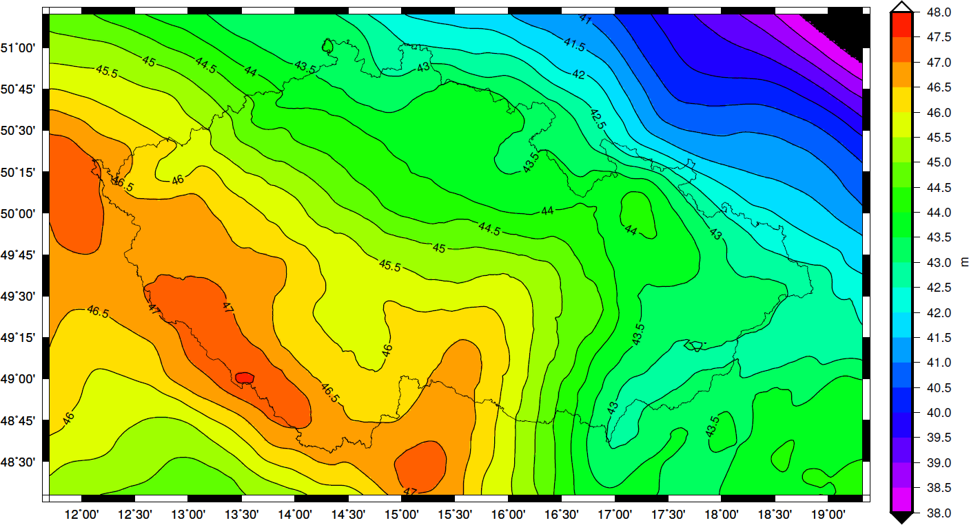
Reference Frames - Height Transformation
European Terrestrial Reference System 1989 (ETRS89)
ellipsoidal heights GRS80
Baltic Height System
(national realization - Bpv)
Quasigeoid QGZÚ-2014
computed in cooperation with Research Institute of Geodesy and Cartography
- new GNSS/gravimetric measurements

Slide 9
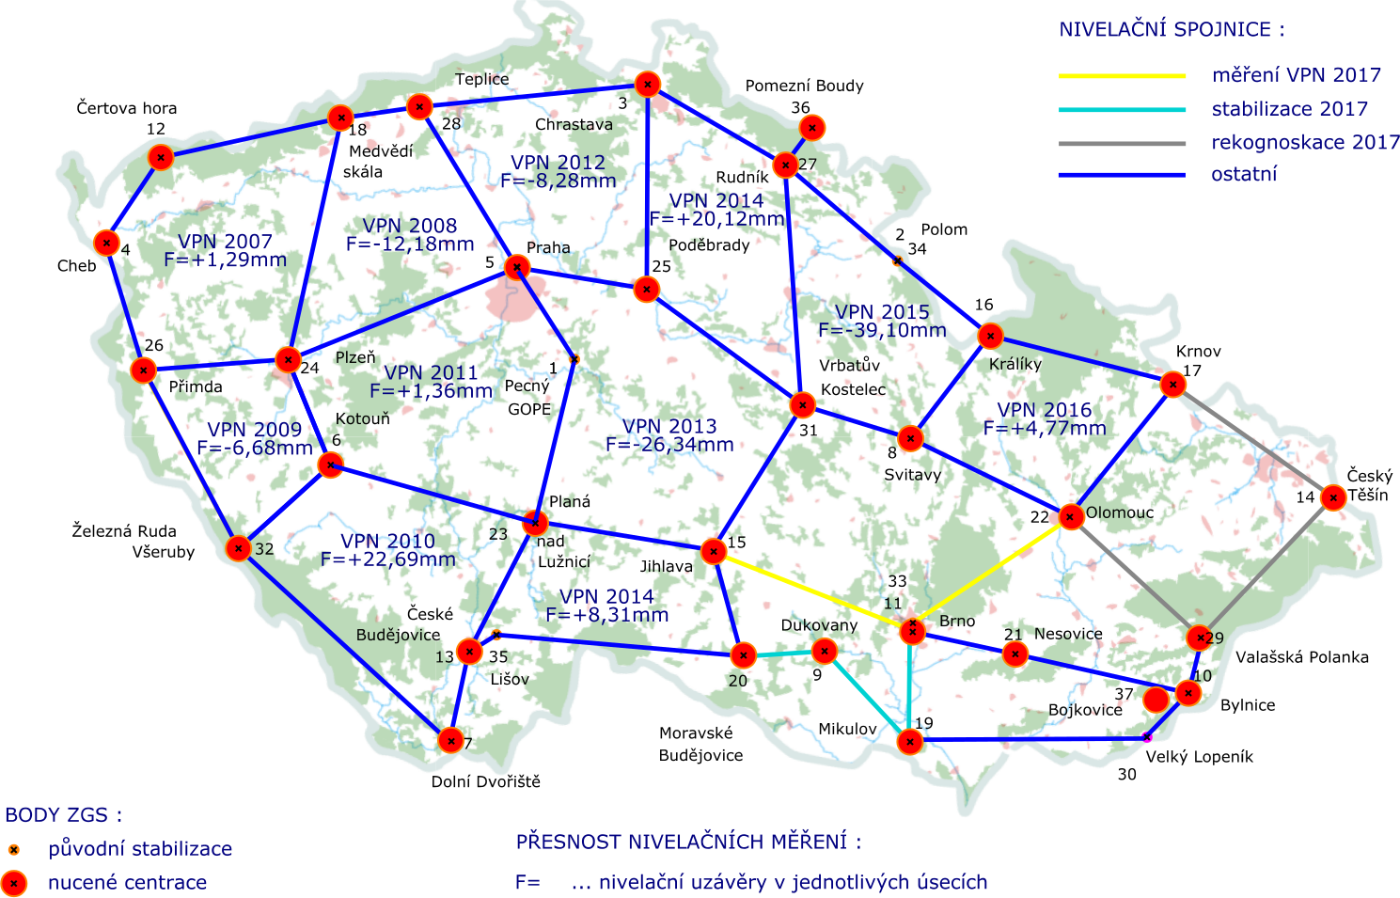
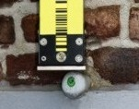
Height Transformation
Baltic Height System
(national realization - Bpv)
European Vertical Reference System (EVRS)
National realization of EVRS - precise leveling → grid densification
2018: results of leveling 2007 – 2016 were sent to BKG (UELN center)

Slide 10
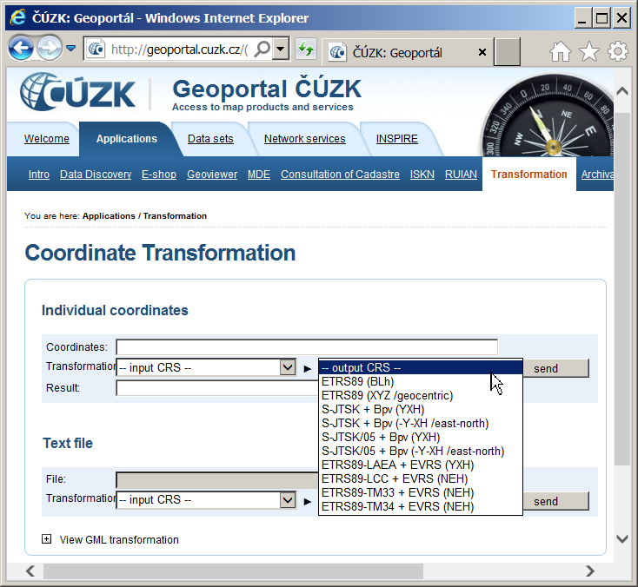
Transformation Service of Geoportal ČÚZK

Slide 11
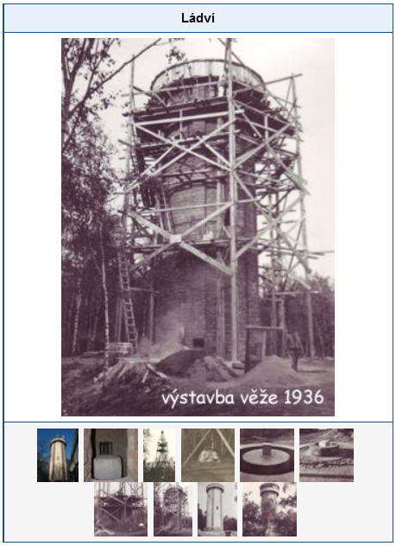
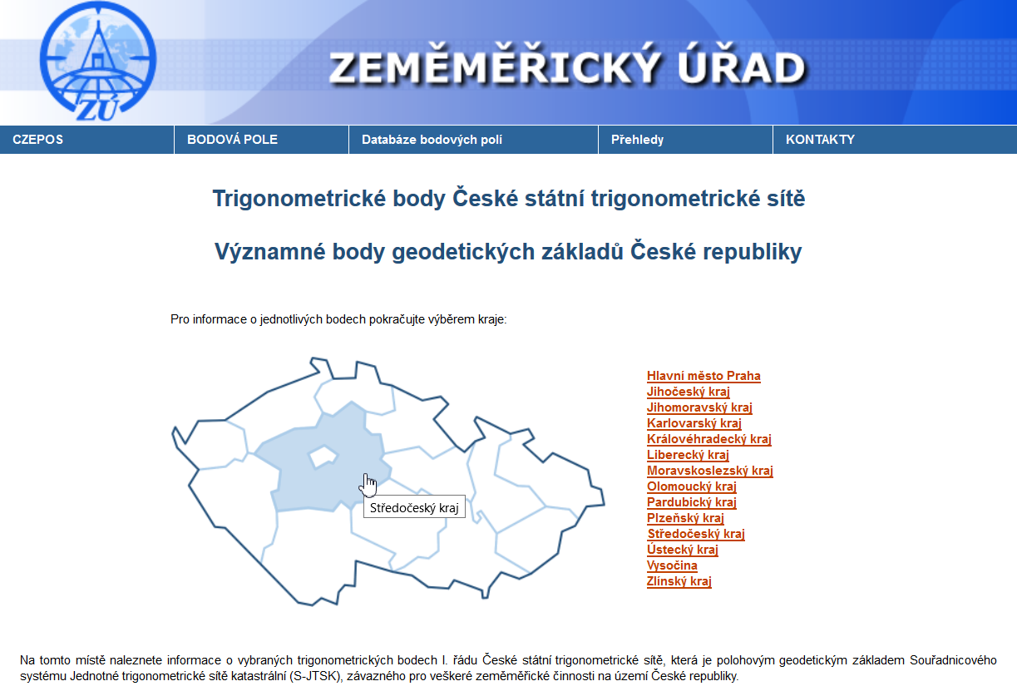
Popularization of historical trigonometric points
https://bodovapole.cuzk.cz/vyznamneTB.aspx
Notes:
Po zpracování a odsouhlasení grafického návrhu informační tabule na základě uvedeného jednání s ČÚZK byly tabule zhotoveny z hliníkového materiálu Dibond s textem chráněným proti UV záření a překrytým ochrannou fólií proti mechanickému poškození. Následně bylo zahájeno její osazování k vybraným bodů z etapy 2017 (celkem bude osazena u 55 TB, v roce 2017 u 12 TB). Webová stránka sloužící k popularizaci těchto bodů se vyhotovuje s termínem dokončení ke konci roku 2017.

Slide 12
Research Institute of Geodesy, Topography and Cartography
Geodetic Observatory Pecný (GOP) - Research Activities
GNSS (Global Navigation Satellite Systems) – data collection, data quality control, data dissemination, precise analysis of regionally and globally collected data
DORIS (Doppler Orbitography and Radiopositioning Integrated by Satellites) – precise analysis of globally collected data,
Gravity field modelling – ground data collection and analyses, processing of data from Low-Earth Orbiter missions and satellite altimetry,
Interdisciplinary research including software development – models and precise products for autonomous positioning applications, meteorology and climatology applications, geophysics and geodynamics applications,
Applied research towards geodetic reference frame realization and maintenance (ETRS89, absolute gravity network)
Applied research in metrology (long lengths, gravity, 3-D position, calibrations of instruments)

Slide 13
Research Institute of Geodesy, Topography and Cartography
Major Space Projects & References
E-GVAP – The EUMETNET EIG GNSS Water Vapour Programme (2005–2019, EUMETNET service)
DARTMA – Development and Assessment of Regional Augmentation Tropospheric Model for GNSS Positioning (2014–2016, ESA contract)
Trop4LAS – Assessment Techniques of Tropospheric Effects for Local Augmentation Systems (2012–2014, ESA contract)
EPOS – European Plate Observing System, Implementation Phase (2015–2019, H2020)
SPMS – EGNOS Service Performance Monitoring (2015–2022, GSA

Slide 14
Research Institute of Geodesy, Topography and Cartography
Major Space Projects & References
GRC-MS – Galileo Reference Centre, support from the member states (2017–2021, GSA)
IGMA – International GNSS Monitoring and Assessment, task force of the International Committee on GNSS, ICG (2017–2020, UN)
GNSS4SWEC – Advanced GNSS Tropospheric Products for Monitoring Severe Weather Events and Climate (2013–2017, EU)
SWIRLS – Galileo Professional Receiver Development (2005–2008, EU FP 6, coordinated by Septentrio Ltd.)
100 global stations for determining the precise orbits and clock corrections for GPS and GLONASS satellites

Slide 15
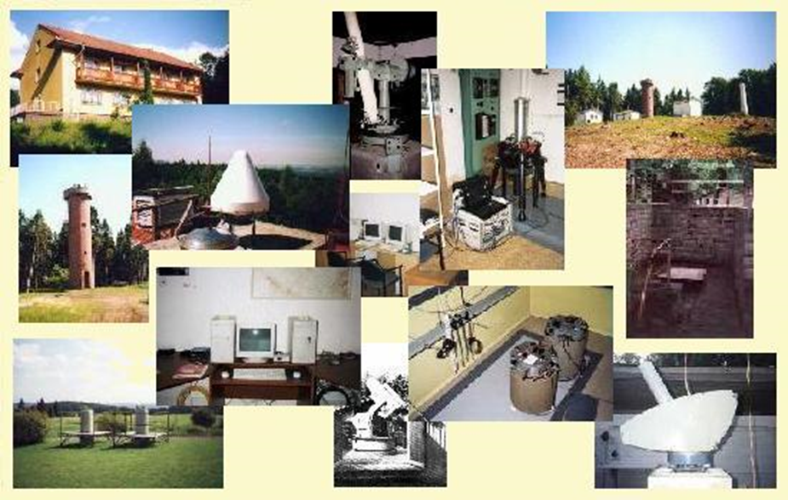
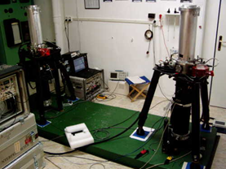
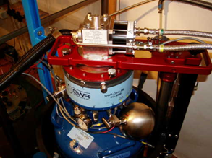
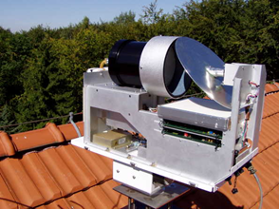
Research Institute of Geodesy, Topography and Cartography
GOP – Labs and Equipment
12 precise (geodetic) GNSS receivers (6 employed in Greece),
atomic Cs-clock (a part of national group standard of time and frequency)
passive H-maser,
2 absolute (FG5 and FG5X), 3 relative and 1 superconducting gravimeter OSG; national gravity standard
water vapour radiometer
3-D VBB seismometer
various meteorological and environmental sensors,
test and calibration baseline for 3-D positioning using GNSS (national reference standard).

Slide 16
Research Institute of Geodesy, Topography and Cartography
GOP: Monitoring and Reporting of all Active CORS Stations in the Czech Republic
Check of stability and quality
Currently 123 stations included in monitoring
Rapid solution used as a basis
EPN processing standards and guidelines
8:00 UTC the daily solution compared with coordinates + statistical test
Limits: 7mm, 7 mm and 15 mm for N,E,U components
Reporting for NMCA (National Mapping and Cadastre Administration)

Slide 17
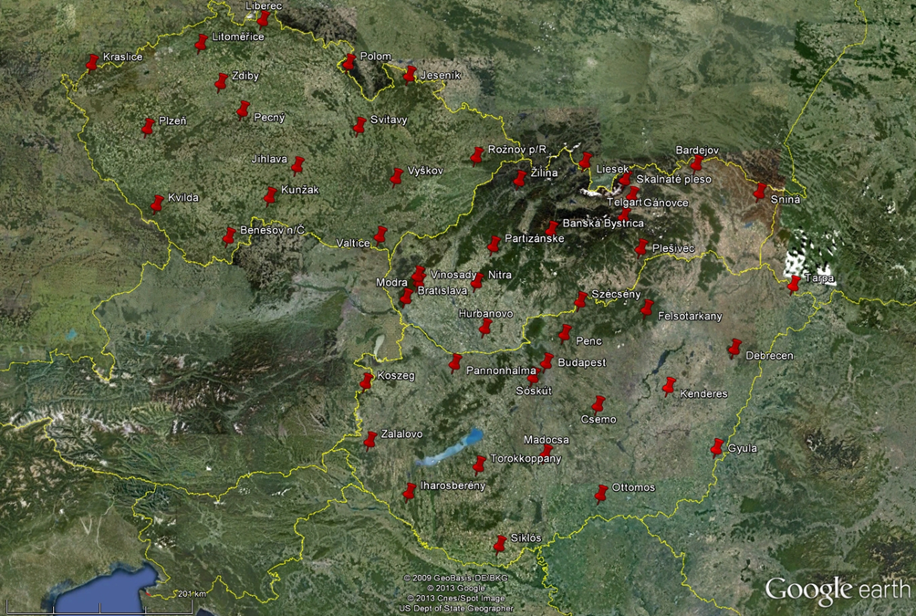
Research Institute of Geodesy, Topography and Cartography
GOP Contribution to Gravity Reference Frame Realization and Maintenance in Czechia, Slovakia and Hungary: Repeated Absolute Gravity Measurements

Slide 18

thank you for your attention
Jan Řezníček
Jaroslav Šimek

