Slide 1

Leuven Institute for Ireland in Europe
Contribution of harmonised Pan European geo-information to EU transport policy: Selected Use Cases
European Commission – DG Mobility & Transport (MOVE)
Luc Heymans – Team Leader-IT Project Officer
09 May 2017

Slide 2
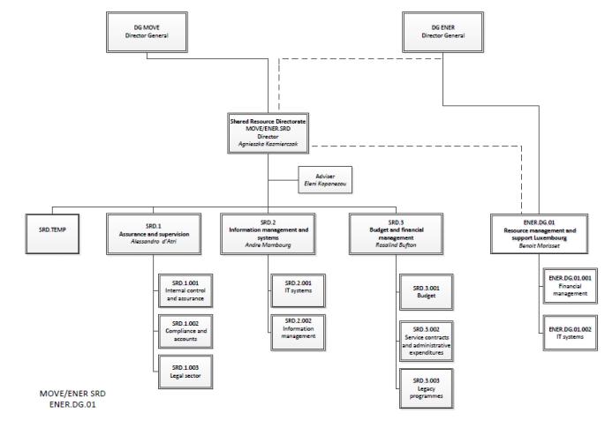
Introduction: Who we are
Geo-information for Transport @ DG MOVE
  Information management & systems
  Supporting activities of 2 DGs of the European Commission:
  DG Mobility & Transport
  DG Energy
  Relying on EC infrastructure
  (DG DIGIT)

Slide 3
Introduction: What we do
Geo-information for Transport @ DG MOVE
Contribute to the evidence based EU transport and energy policy making by:
  Timely delivering Information Systems solutions
  Storing and managing policy related information & data
  Delivering add-hoc reporting solutions
  Fostering the dissemination of data & information (internal & public)
  Spatial component is important in transport
  Geo-information and GIS is widely used

Slide 4
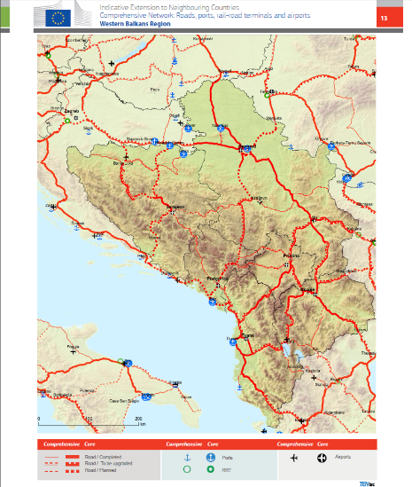
Data: the backbone of policy making
Geo-information for Transport @ DG MOVE
Web applications combining background services (OSM, ESRI, … and authoritative datasets (Eurogeographics, European Commission, …)
Data collection and data management
Mapping (Ad-hoc map production for presentations,
legal documents, briefings, missions and reports)
→ Better decision Making
→ Improved Communication

Slide 5

Eurogeographics datasets commonly used
Geo-information for Transport @ DG MOVE
EuroBoundaryMap (country and NUTS boundaries)
EuroRegionalMap
  Transport network
  Water network
  Settlement theme

Slide 6
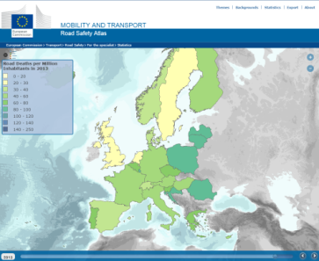
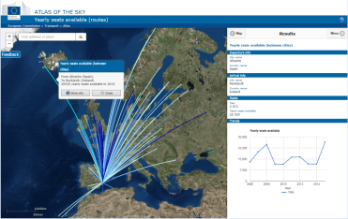
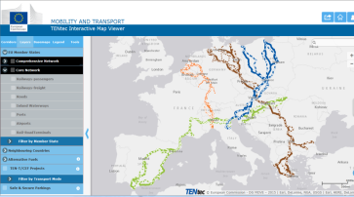
Use Cases
Geo-information for Transport @ DG MOVE
Road Safety
Air Transport
TEN-T (TENtec)

Slide 7
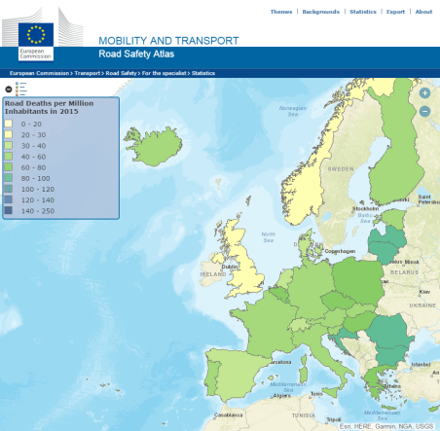
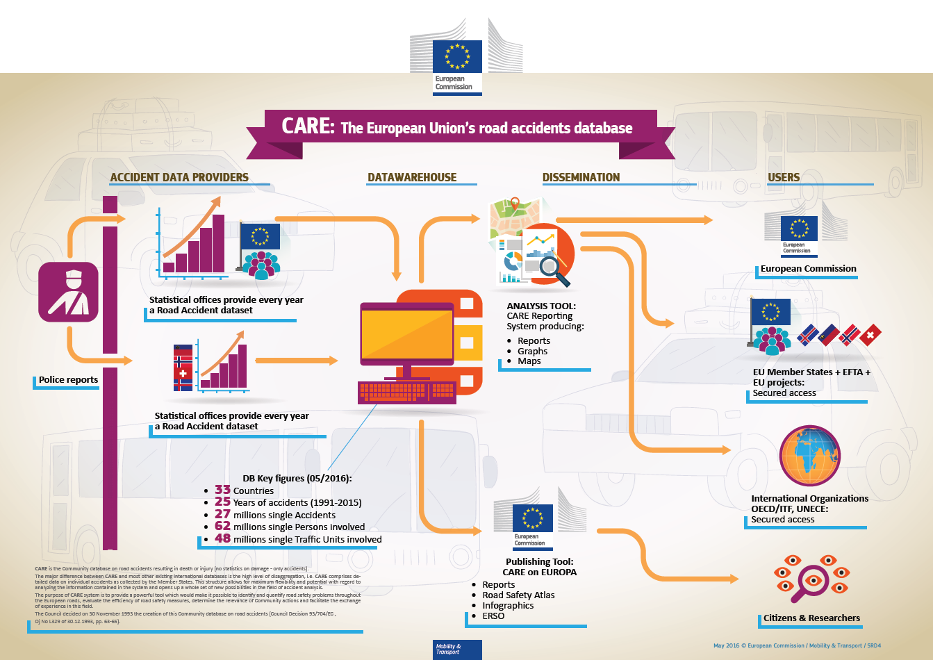
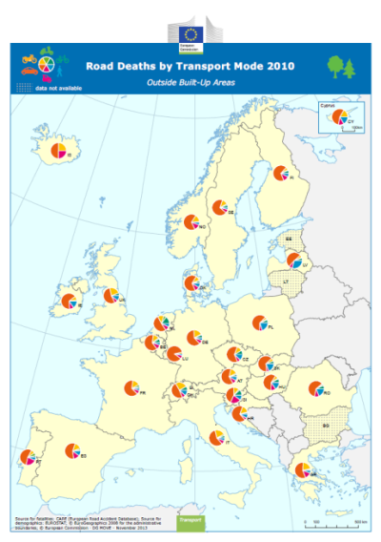
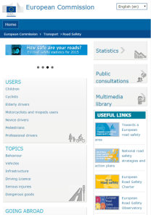
Geo-information in support of the European Road Safety Policy
Geo-information for Transport @ DG MOVE
http://ec.europa.eu/transport/road_safety/specialist/statistics/map-viewer/

Slide 8
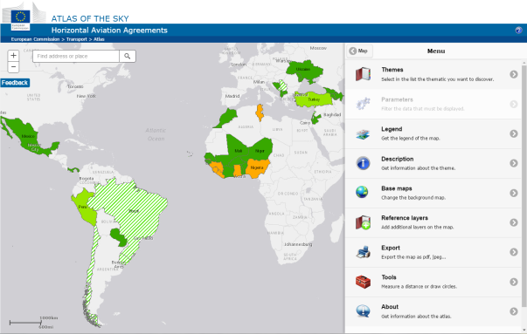
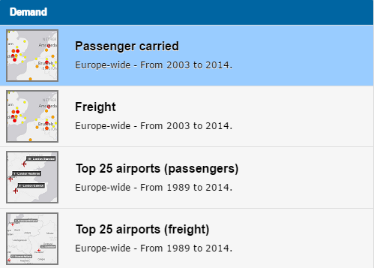
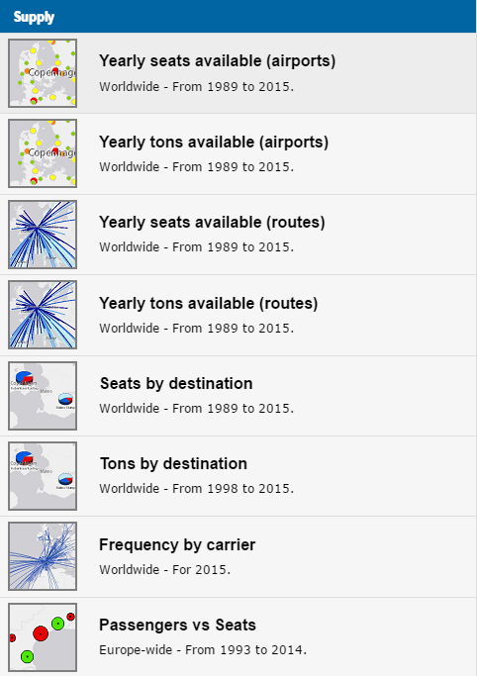
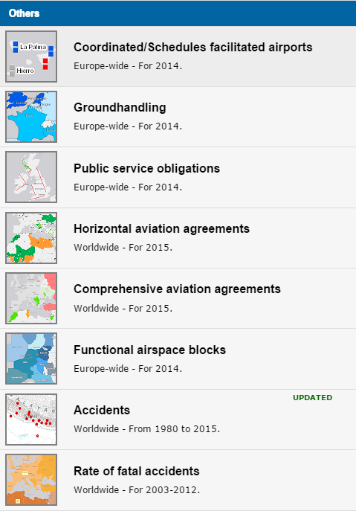
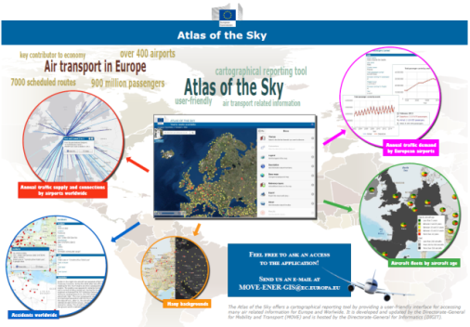

The Atlas of the Sky: easy access to air transport information
Geo-information for Transport @ DG MOVE
Single point of access
Modern way of presentation
Easy access to information

Slide 9

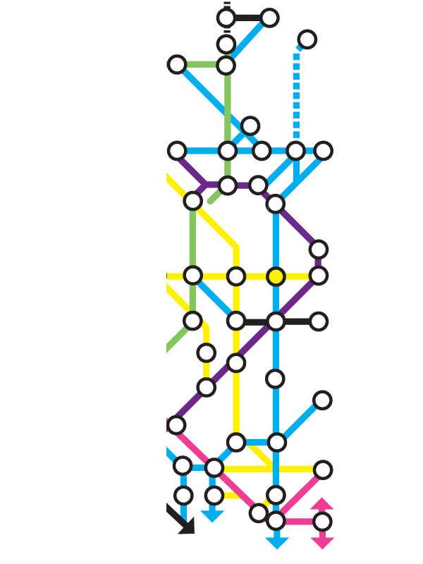
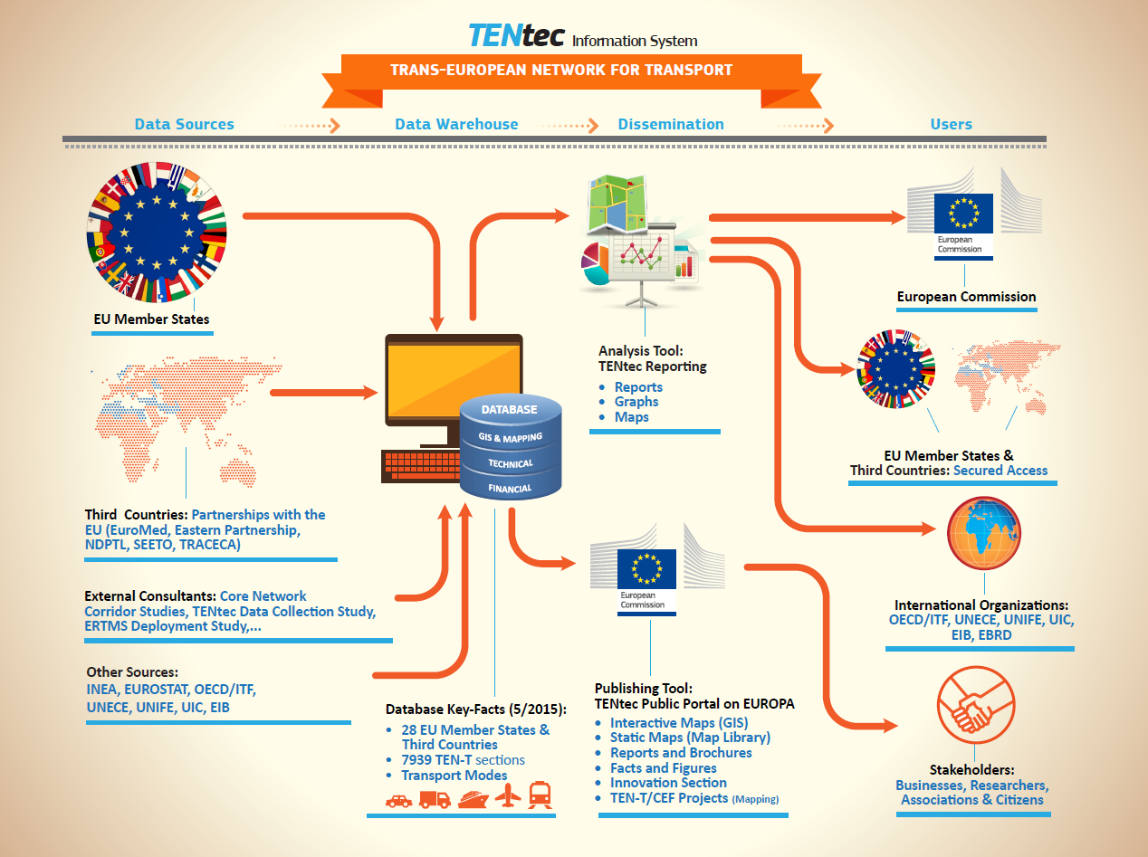
TENtec Information System (TEN-T)
Geo-information for Transport @ DG MOVE

Slide 10
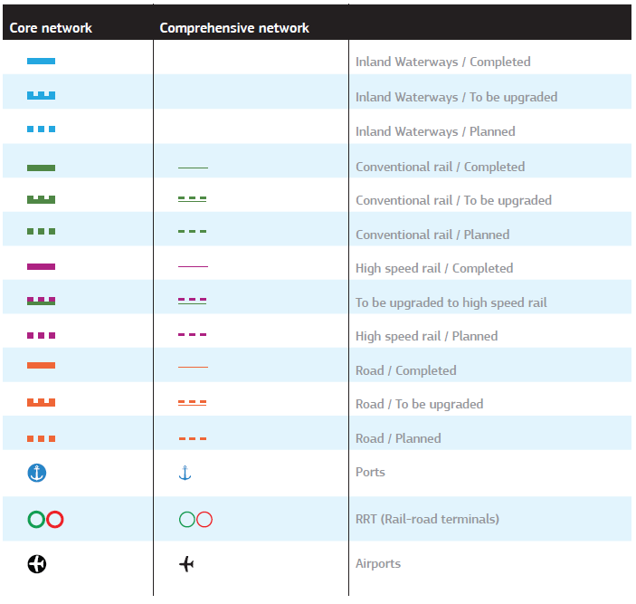
The TEN-T Scope
Geo-information for Transport @ DG MOVE
Roads infrastructure
Railways infrastructure
Inland Waterways infrastructure
Ports
Airports
Rail Road Terminals (Multimodal platforms)

Slide 11
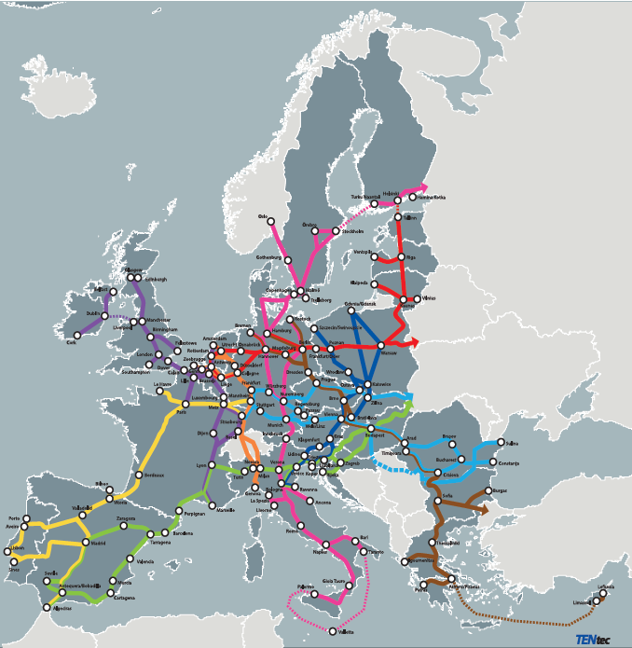
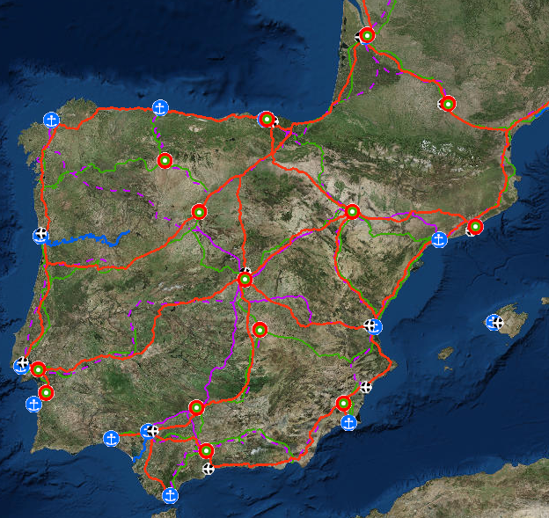
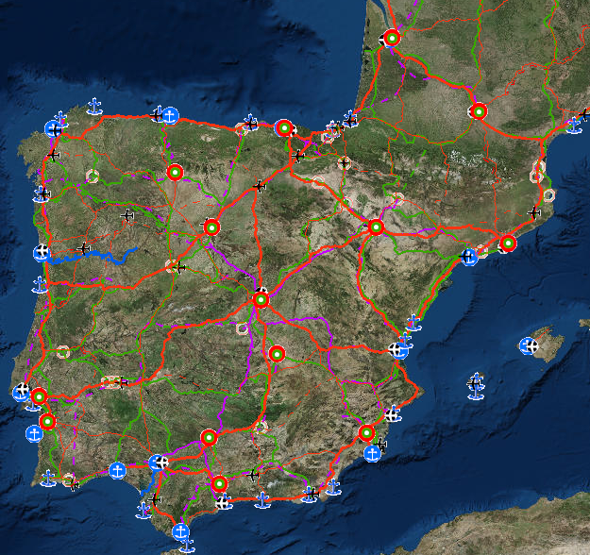
3 levels of granularity
Geo-information for Transport @ DG MOVE
Corridors
Core Networks
Comprehensive
Networks

Slide 12
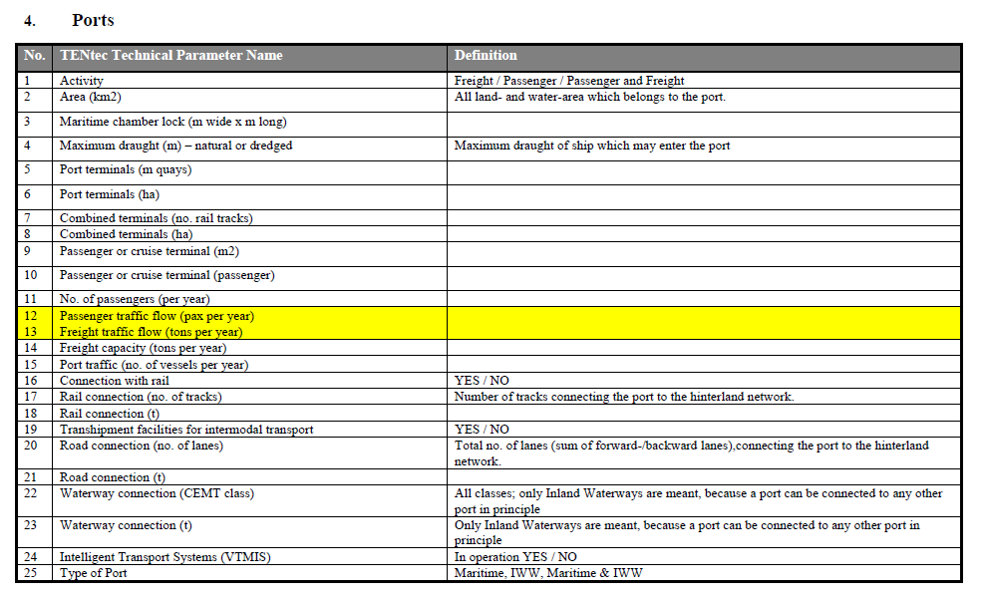
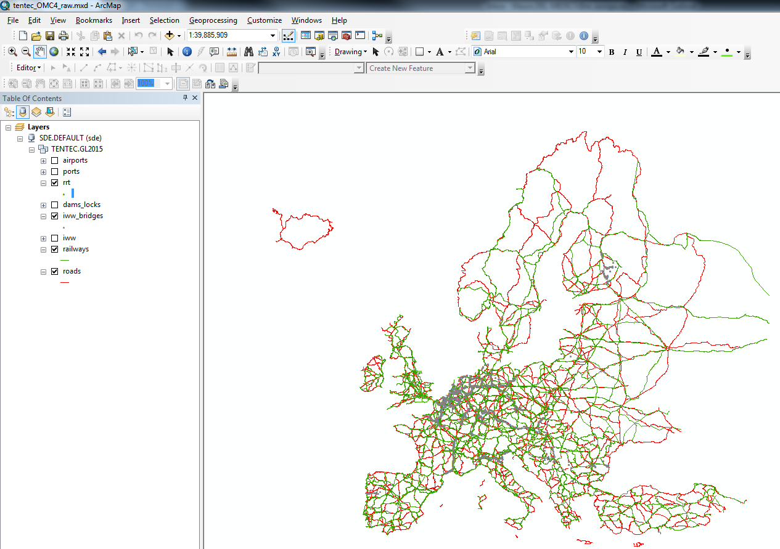
Database & geodatabase
Geo-information for Transport @ DG MOVE

Slide 13

TEN-T data quality problems
GIS for Transport @ DG MOVE
Manually created from the schematic descriptions defined in the TEN-T legal basis (2013) → Slow process with poor geometry quality and no topology
Low filling rates for some attributes (names, official ids…)
Needs for new transport modes (dams, bridges…)

Slide 14
Search for a reference network
GIS for Transport @ DG MOVE
Good coverage of Europe
Data for different transport modes (Roads, Railways, IWW, airports, ports, stations, dams, ferry lines…)
Relatively good quality for geometry and topology
Authoritative source
Frequent updates

Slide 15
ERM choice
GIS for Transport @ DG MOVE
Pros:
  Authoritative source
  All needed transport modes available
  Good positional accuracy and geometric quality and coverage
  Yearly updates
Cons:
  Some missing countries
  Attribute filling rates (Names (dams,…), street numbers, railways …)

Slide 16
Improving TEN-T network based on ERM
GIS for Transport @ DG MOVE
Alignment of TEN-T sections to ERM
Creation of new features with attributes (dams, bridges) from ERM
Split TEN-T sections based on ERM

Slide 17
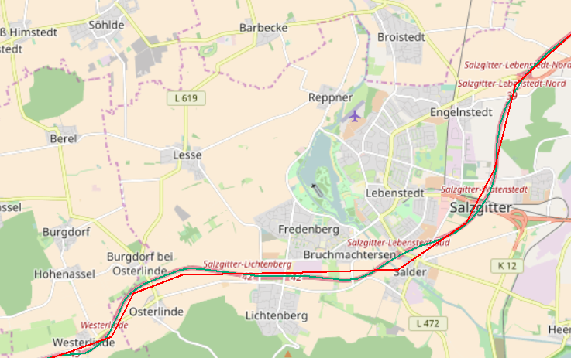
Improvements: alignment of TEN-T to ERM
GIS for Transport @ DG MOVE

Slide 18
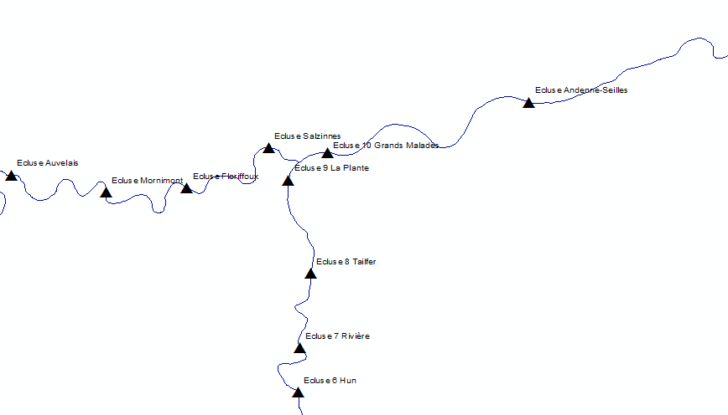
Improvements: Creation of new features (dams)
GIS for Transport @ DG MOVE
Extract dams from ERM via selection by location (buffering) along the existing TEN-T IWW lines
Snap the result on existing IWW lines
Combine attributes coming from TEN-T IWW and ERM

Slide 19
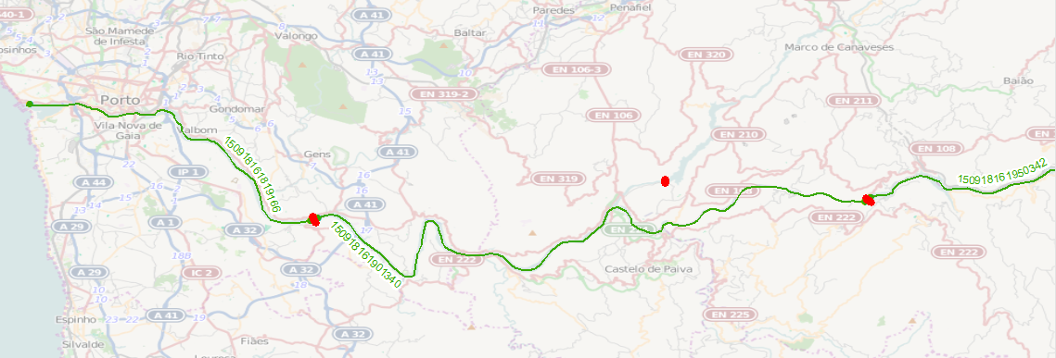
Improvements: Split waterways sections based on dams/locks dataset from ERM
GIS for Transport @ DG MOVE

Slide 20
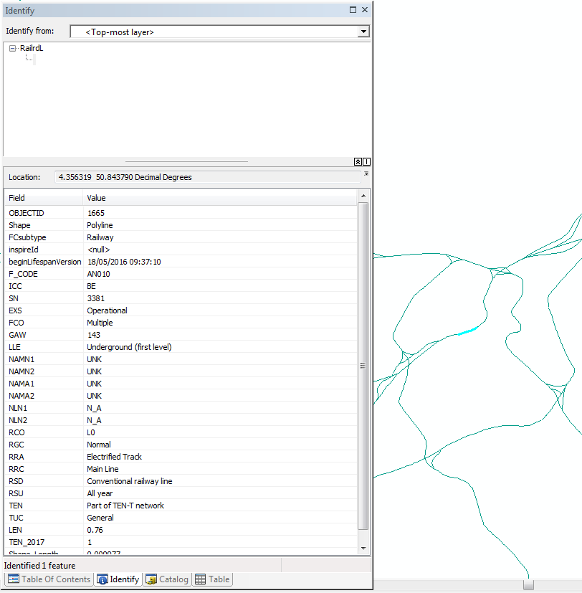
Integration of TEN-T section ID in ERM
GIS for Transport @ DG MOVE
ERM v10 Roads, Railways & IWW
new field added "TEN_2017"
contains the updated values calculated for the TEN field (1= in TEN-T network)
Calculated via a script and manual corrections

Slide 21
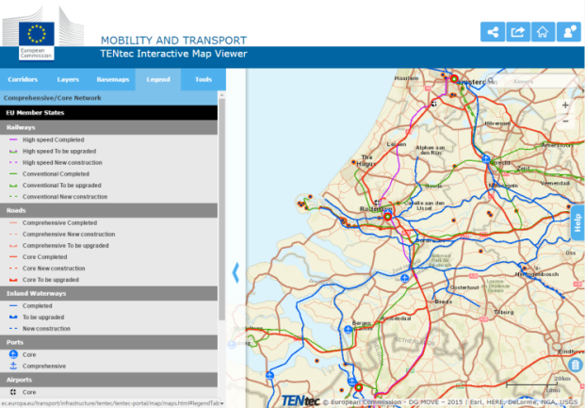

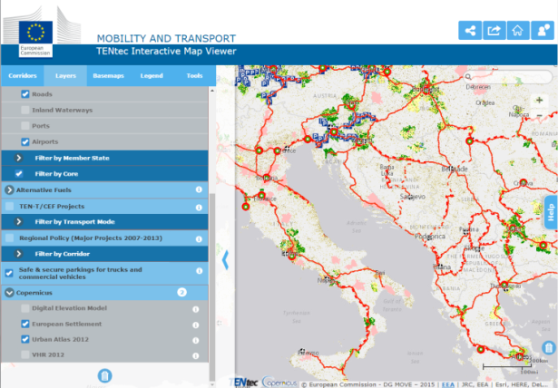
TENtec Public Map Viewer
Geo-information for Transport @ DG MOVE
Provides the user with an optimal viewing experience accross a wide range of devices, including mobile devices
http://ec.europa.eu/transport/infrastructure/tentec/tentec-portal/map/mobile.html

Slide 22


Thank you for your attention!
Geo-information for Transport @ DG MOVE
No. Now I want to go out for a pizza…
Questions?

