Slide 1
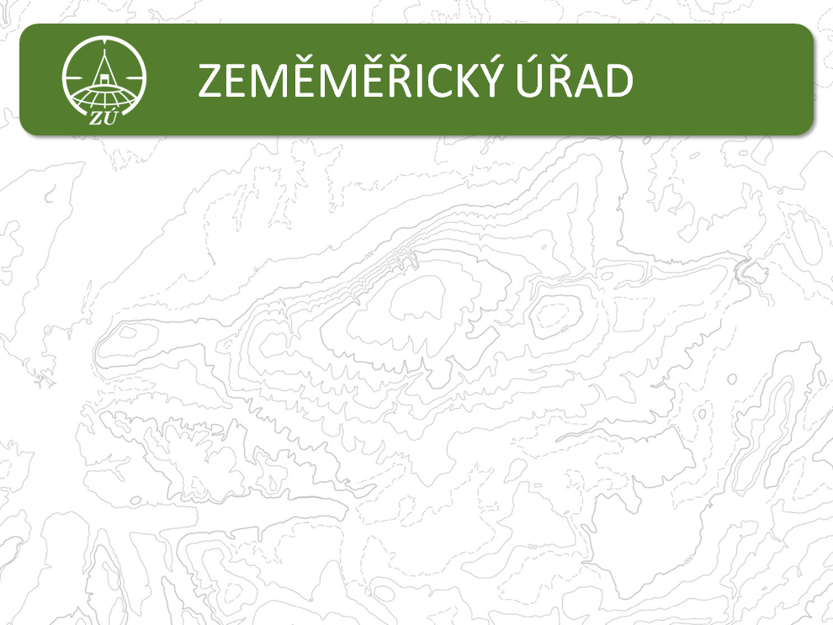


SBE KEN
National Report of the Czech Republic:
Connecting state boundaries to ETRS89
Czech Office for Surveying, Mapping and Cadastre
Land Survey Office, Department of Geodetic Control

Slide 2
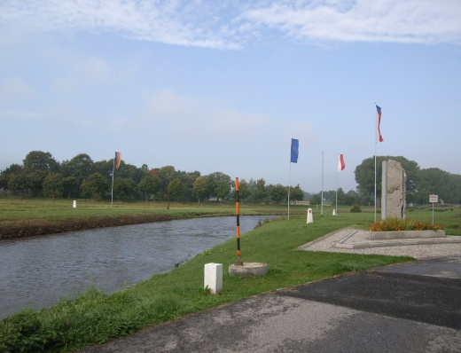
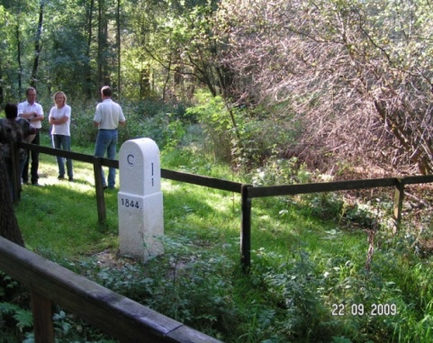
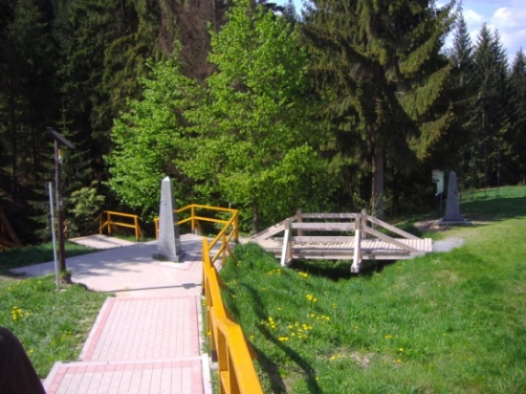
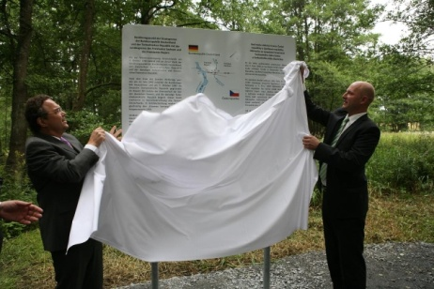
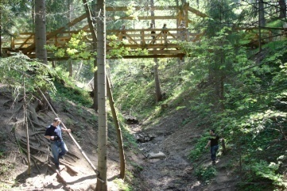
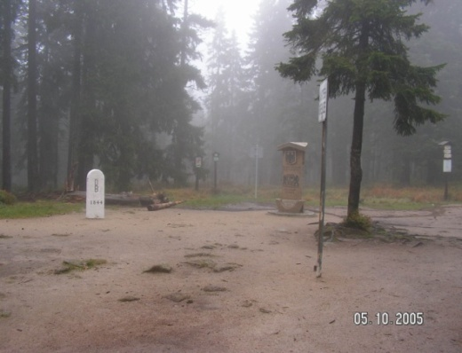
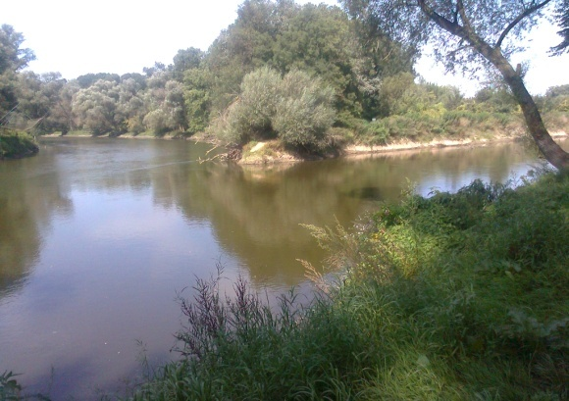
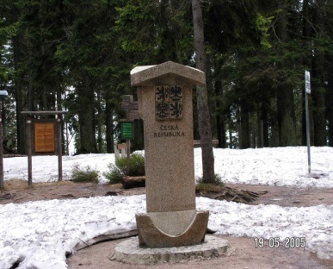
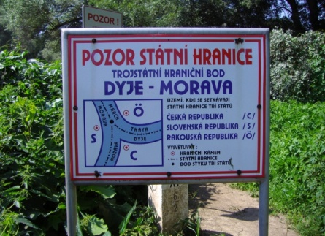
Geodetic Activities at the State Boundaries
796,0 km
453,9 km
356,2 km
Total length:
2 322,0 km
251,8 km
464,1 km
- administrator of state boundaries: Ministry of Interior of the Czech Republic
- geodetic activities: Land Survey Office

Slide 3
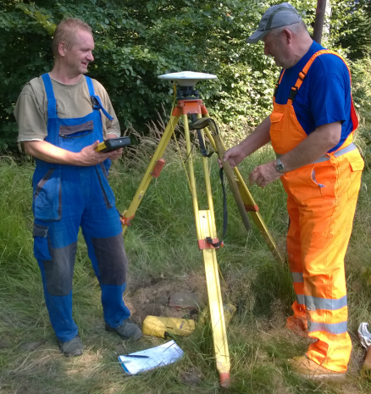
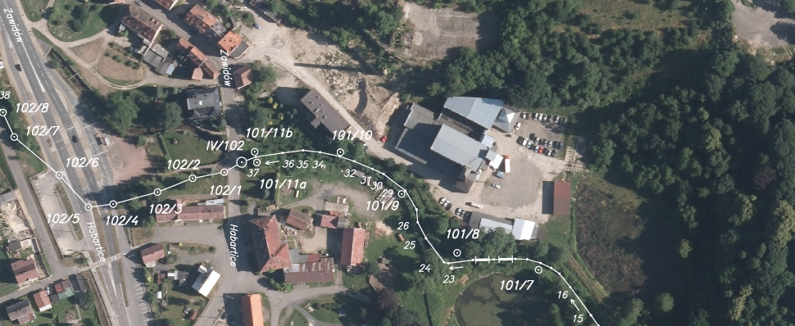
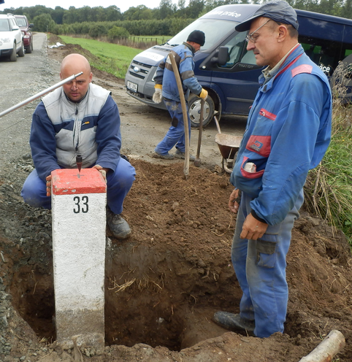
Geodetic Activities at the State Boundaries
- transformation of state boundaries to ETRS89
(new GNSS measurements)
- utilization of photogrammetry / laserscanning;
new documentation of state boundaries
          periodical
maintenance of state boundaries

Slide 4
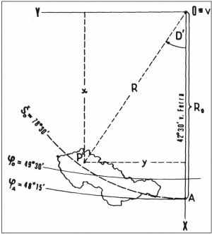
Aspects of Transformation to ETRS89
European Terrestrial Reference System 1989 (ETRS89)
Coordinate System of Uniform Trigonometric Cadastral Network
(S-JTSK)
3D Helmert transformation
equations of Krovak projection
application of local differences – deformations of S-JTSK

Slide 5
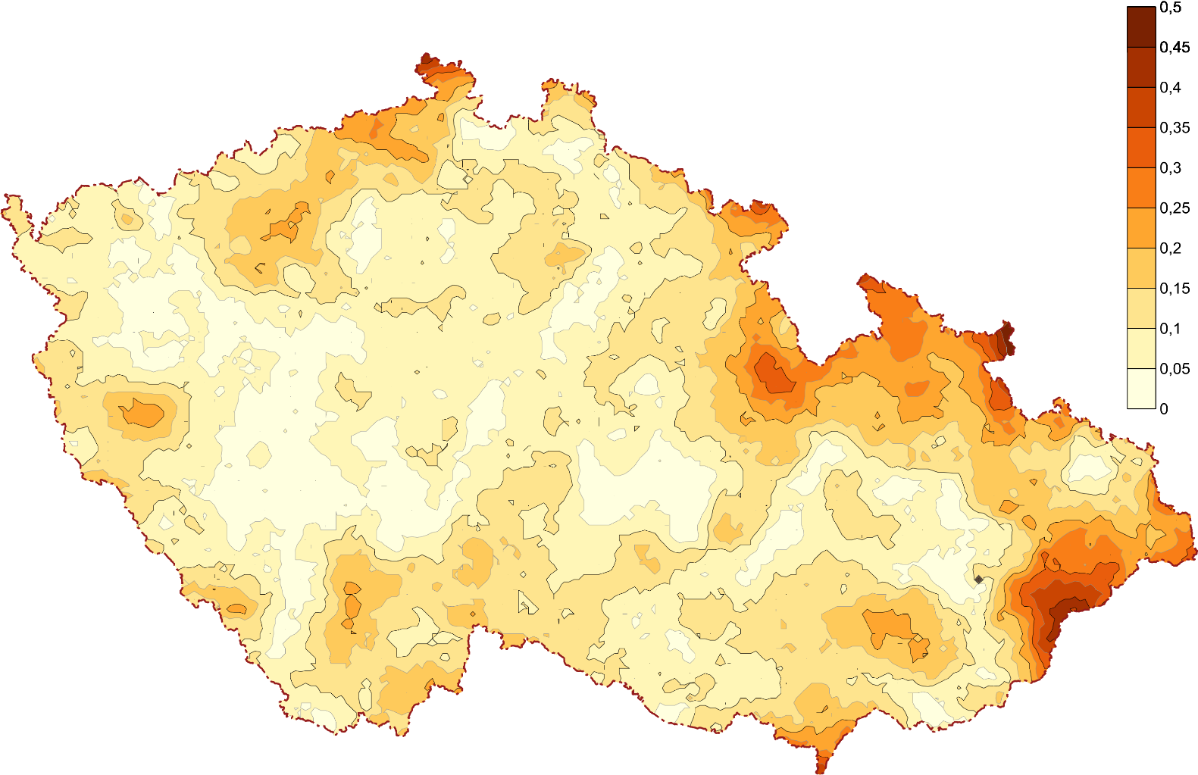
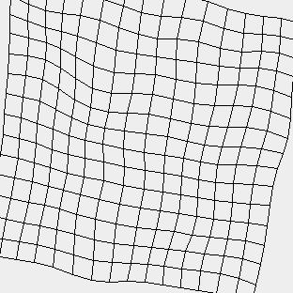
Positional Transformation – grid of local differencies
- Previous grid — realization 2012
- New realization 2017:
new GNSS measurements 2014-2017, smoother changes
higher density of points in the areas of state boundaries

Slide 6
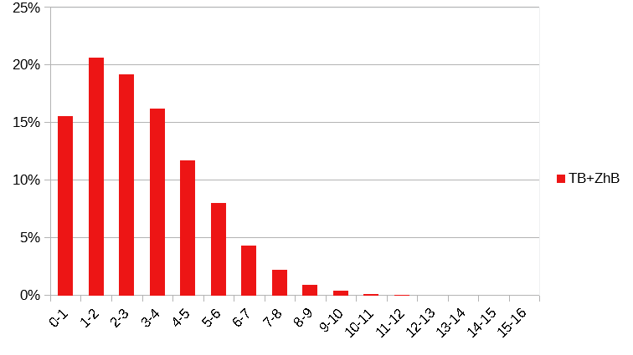
Positional Transformation – grid of local differencies
accurcy of transformation in cm
m_{p} = 3,6 cm

Slide 7
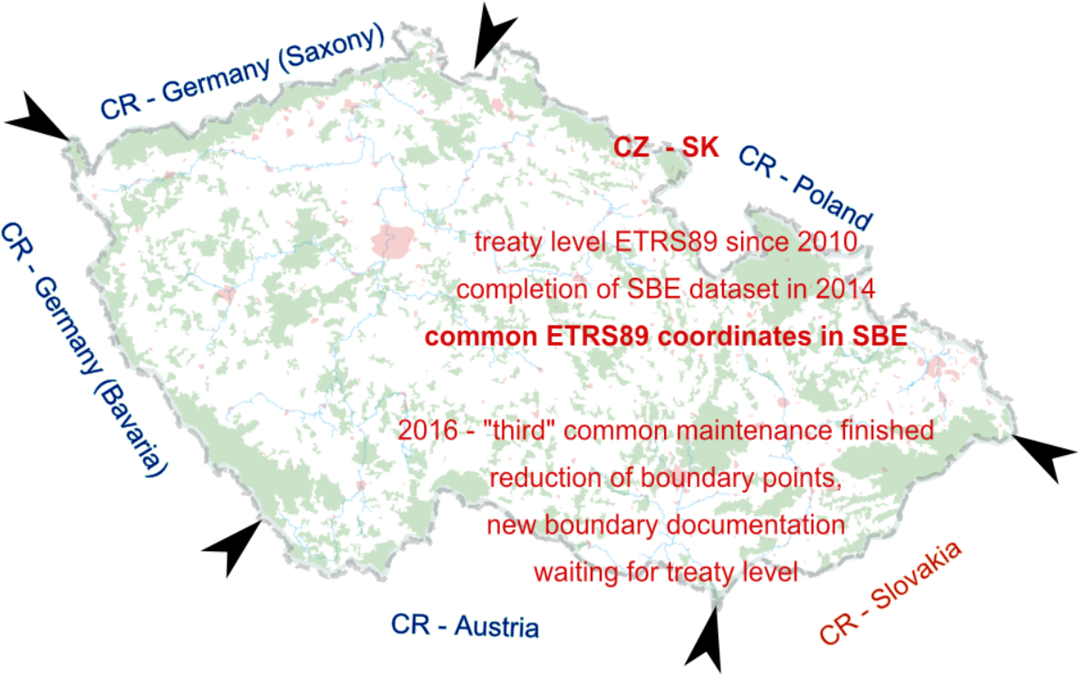
CR - Slovakia

Slide 8
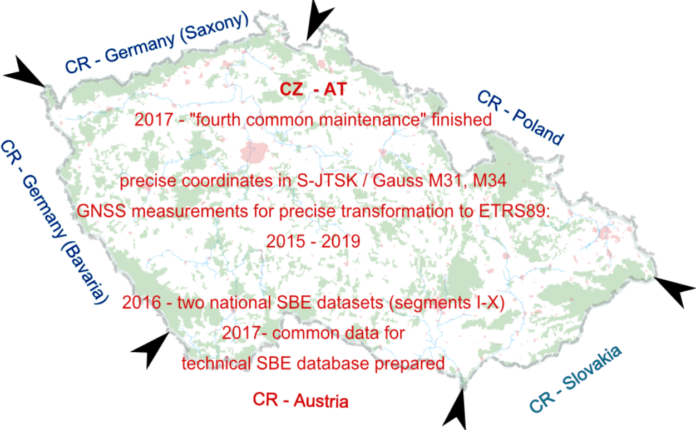
CR - Austria

Slide 9
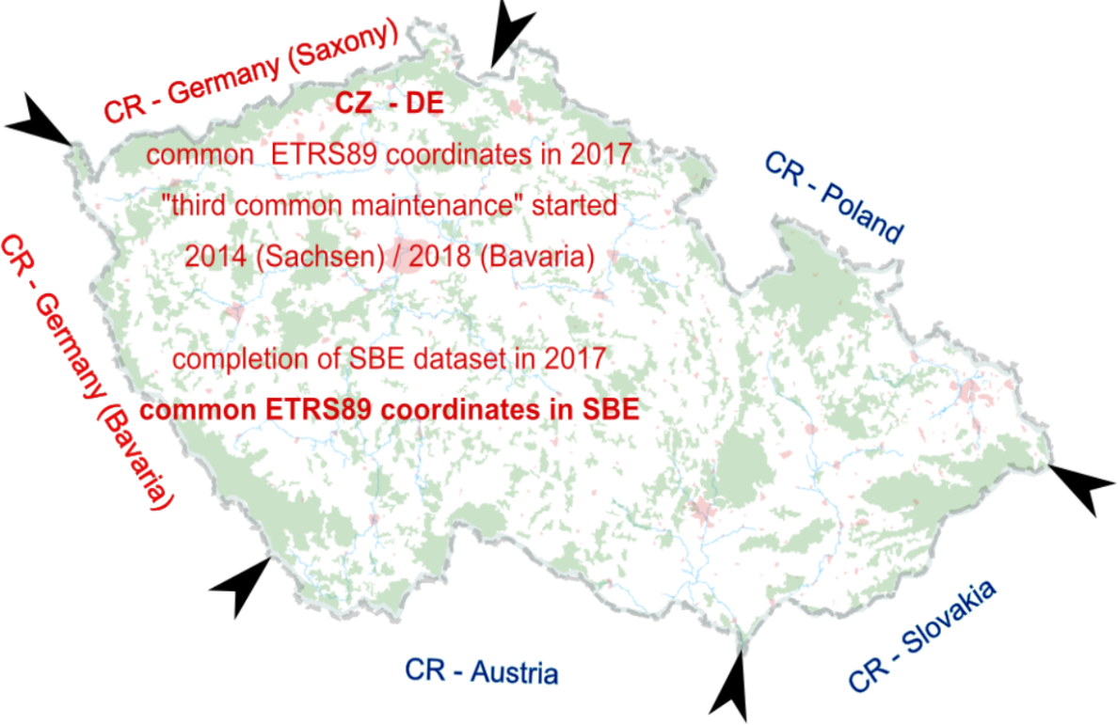
CR - Germany

Slide 10
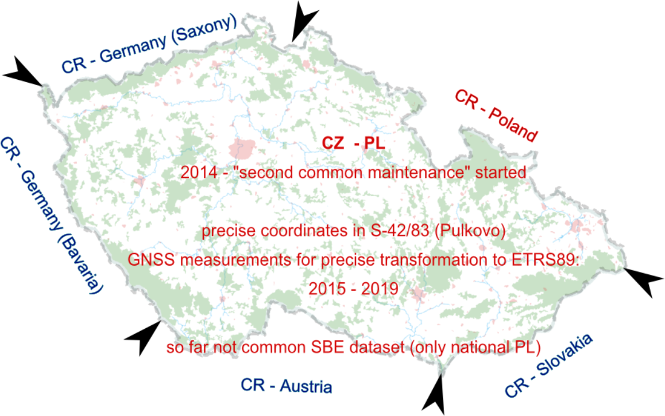
CR - Poland

Slide 11
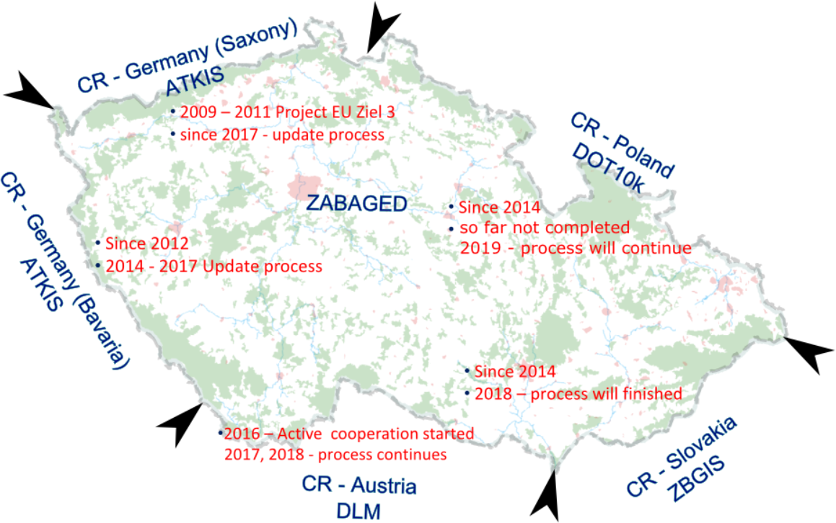
Harmonization of Geographical Data

Slide 12

thank you for your attention

